Slide 1
The Components of a Successful Dental Schedule
LaJuan Mountain DMD
Joseph Mountain DMD

Slide 2
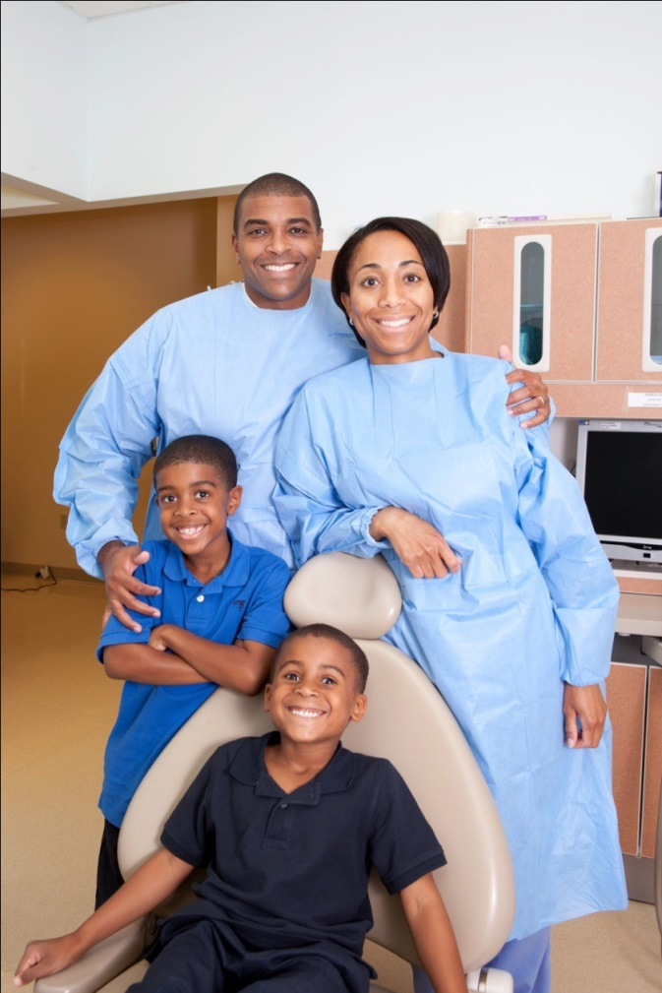
Who we are
Dental Directors at Family First Health, a federally qualified health center in south central Pennsylvania
Comprehensive care (preventative, restorative, removable, crown and bridge, endo, & extractions)
For patients of all ages
Three sites, with a total of 20 operatories in York and Adams counties

Slide 3
Learning Objectives
Learn to develop a successful dental schedule
Learn to develop a scheduling template
Question and Answer session at the end of the lecture

Slide 4
How do you currently schedule?
We utilize scheduling templates for all scheduling in our practice.
Several variations of our base templates for our staff of 11 providers.
Hygiene specific templates
Dentist with EFDA templates etc.
Templates range from 7 patients per day for a new graduate to 28 patients per day for our top producing teams.

Slide 5
Scheduling Templates Won’t Fix Every Problem
Provider Issues
Skill set
Open minded to work within the template
Reimbursement Issues
Organizational Philosophy Issues
Willingness to communicate budget goals
Willingness to develop and enforce policies
Philosophy disconnect (administrative vs. clinical)
Staff Training
Limited Office Size

Slide 6
Variables to consider when designing a dental schedule
Demand for care
Who’s in charge of the day??????
Reimbursement mix
Number of Operatories
Average no show rate
What patient group no shows the most?
What time of day averages the most no shows?
Budget expectation for visits per hour
Support staff
Provider skill set

Slide 7
Demand for Care
Understand how patients gain access to your practice & how appointments are scheduled
Wait list
Scheduling beyond 30 days
Patient expectations for walk in care vs. scheduled visits.
What procedures are in highest demand?
Is your scheduling organized and predictable or random and unpredictable?
They can all work, but how does it work best for your practice?

Slide 8
Who’s in charge of the day?
Who decides what scheduling system the practice will use?
Front desk
Providers
Administrative team
Who will be the scheduling champion?
What problems do you have in your current schedule?
Solve your scheduling problems one by one

Slide 9
Reimbursement
Understand how reimbursement works in your practice.
What is your percentage of self pay?
What is your percentage of insurance patients?
Are high demand procedures reimbursed well?
Use your reimbursement information to build a profitable schedule each day.

Slide 10
Reimbursement Continued
Understand the visits that:
Generate positive revenue
Break even
Loose money
Deploy providers accordingly
Example: Provider X is very slow with extractions and doesn’t enjoy them but is efficient with Pedo. Increase provider x’s pedo and redirect their extractions to another provider that enjoys the procedure.

Slide 11
Operatory Utilization
Always understand when you have operatories available
Schedule for each operatory and maximize your space
Example: One provider is out of the office, schedule the practice for increased productivity but limit productivity to only include procedures that can be handled by one provider with surplus support staff (easier room turnover, X-rays etc.).

Slide 12
No Shows
What’s the no show rate for your practice?
What patient group no shows the most?
What time of day has the most no shows?
What provider type has the most no shows?
Hygiene
Dentist
New provider or established provider
What procedure type has the most no shows?

Slide 13
Dealing With No Shows
A no show policy is needed
A late arrival policy is needed
Schedule groups with high no show potential into defined blocks of time and overbook during that time.
Example: consistent high no shows in afternoon with new patients. Create a new patient block for several providers during this time and double book new patients.

Slide 14
Support Staff
Increased standardization in your practice compensates for a less experienced staff
Do you have qualified assistants?
Do you train on the job or only hire experienced staff?
Do you utilize EFDA’s, are they well trained?
Do you hire experienced EFDA’s or train new grads?
Is your front desk adequately trained?
Is scheduling a source of frustration in the practice?
Tension between front office and clinical teams.
Consider cross training

Slide 15
Staff improvement:
Using a template often helps staff understand the pace and expectations for the day.
Scheduling standardization (template utilization)
compensates for lack of experience
Helps management appropriately allocate staff
Improves equipment utilization efficiency
Decreases stress in practice

Slide 16
Provider Skill Set
Understand your providers strengths and areas of needed development
All providers are not created equally
Hire for fit. During the interview process be realistic and upfront about challenges of practice, work conditions, practice philosophy and expected productivity.
This will lead to increased retention and job satisfaction.

Slide 17
Communicate with Providers
Once providers are on board communicate with them OFTEN.
Discuss
Visits needed per hour
Visit types provided in practice
Make sure their treatment philosophy matches the organizational & department philosophies.
Educate providers on the differences in reimbursement types (sliding fee scale & insurance).
Include providers in visit conversations. THIS IS ESSENTIAL.
Visits should be scheduled from a template. This gives a starting point of predictability and consistency.
The template should be co-created with your providers. Clear goals & parameters should be established first.

Slide 18
Base Template:
 |  |  |  | 14 Patient Sample base Template
 |  |  |  | 8AM
 |  | CHAIR 1 |  |  |  | CHAIR 2
8:00 |  |  |  | 8:00
8:10 |  |  |  | 8:10
8:20 |  | Patient 1 |  | 8:20 |  | Patient 2
8:30 |  | 8:00am |  | 8:30 |  | 8:00am
8:40 |  |  |  | 8:40
8:50 |  |  |  | 8:50
9:00 |  |  |  | 9:00
9:10 |  |  |  | 9:10
9:20 |  | Patient 3 |  | 9:20 |  | Patient 4
9:30 |  | 9:00am |  | 9:30 |  | 9:00am
9:40 |  |  |  | 9:40
9:50 |  |  |  | 9:50
10:00 |  |  |  | 10:00
10:10 |  |  |  | 10:10
10:20 |  | Patient 5 |  | 10:20 |  | Patient 6
10:30 |  | 10:00am |  | 10:30 |  | 10:00am
10:40 |  |  |  | 10:40
10:50 |  |  |  | 10:50
11:00 |  |  |  | 11:00
11:10 |  |  |  | 11:10
11:20 |  | Patient 7 |  | 11:20 |  | Patient 8
11:30 |  | 11:00am |  | 11:30 |  | 11:00am
11:40 |  |  |  | 11:40
11:50 |  |  |  | 11:50
12:00 |  |  |  | 12:00
12:10 |  |  |  | 12:10
12:20 |  | LUNCH |  | 12:20 |  | LUNCH
12:30 |  |  |  | 12:30
12:40 |  |  |  | 12:40
12:50 |  |  |  | 12:50
1:00 |  |  |  | 1:00
1:10 |  |  |  | 1:10
1:20 |  | Patient 9 |  | 1:20 |  | Patient 10
1:30 |  | 1:00pm |  | 1:30 |  | 1:00pm
1:40 |  |  |  | 1:40
1:50 |  |  |  | 1:50
2:00 |  |  |  | 2:00
2:10 |  |  |  | 2:10
2:20 |  | Patient 11 |  | 2:20 |  | Patient 12
2:30 |  | 2:00pm |  | 2:30 |  | 2:00pm
2:40 |  |  |  | 2:40
2:50 |  |  |  | 2:50
3:00 |  |  |  | 3:00
3:10 |  |  |  | 3:10
3:20 |  | Patient 13 |  | 3:20 |  | Patient 14
3:30 |  | 3:00pm |  | 3:30 |  | 3:00pm
3:40 |  |  |  | 3:40
3:50 |  |  |  | 3:50
4:00 |  |  |  | 4:00
4:10 |  |  |  | 4:10
4:20 |  |  |  | 4:20
14 visits per day will provide 1.49 visits per hour with at a 20% no show rate.
1.49 visits per hour = 11.18 visits per day (7.5hrs work day)
20% no show rate = 2.8 visits
To increase productivity:
Add a third chair
Add a fourth chair
Add an additional visit at the end of the day
Offer 30 minute visits
Work in same day appointments when patients cancel

Slide 19
Template tips
 |  |  |  | 14 Patient Sample base Template
 |  |  |  | 8AM
 |  | CHAIR 1 |  |  |  | CHAIR 2
8:00 |  |  |  | 8:00
8:10 |  |  |  | 8:10
8:20 |  | Patient 1 |  | 8:20 |  | Patient 2
8:30 |  | 8:00am |  | 8:30 |  | 8:00am
8:40 |  |  |  | 8:40
8:50 |  |  |  | 8:50
9:00 |  |  |  | 9:00
9:10 |  |  |  | 9:10
9:20 |  | Patient 3 |  | 9:20 |  | Patient 4
9:30 |  | 9:00am |  | 9:30 |  | 9:00am
9:40 |  |  |  | 9:40
9:50 |  |  |  | 9:50
10:00 |  |  |  | 10:00
10:10 |  |  |  | 10:10
10:20 |  | Patient 5 |  | 10:20 |  | Patient 6
10:30 |  | 10:00am |  | 10:30 |  | 10:00am
10:40 |  |  |  | 10:40
10:50 |  |  |  | 10:50
11:00 |  |  |  | 11:00
11:10 |  |  |  | 11:10
11:20 |  | Patient 7 |  | 11:20 |  | Patient 8
11:30 |  | 11:00am |  | 11:30 |  | 11:00am
11:40 |  |  |  | 11:40
11:50 |  |  |  | 11:50
12:00 |  |  |  | 12:00
12:10 |  |  |  | 12:10
12:20 |  | LUNCH |  | 12:20 |  | LUNCH
12:30 |  |  |  | 12:30
12:40 |  |  |  | 12:40
12:50 |  |  |  | 12:50
1:00 |  |  |  | 1:00
1:10 |  |  |  | 1:10
1:20 |  | Patient 9 |  | 1:20 |  | Patient 10
1:30 |  | 1:00pm |  | 1:30 |  | 1:00pm
1:40 |  |  |  | 1:40
1:50 |  |  |  | 1:50
2:00 |  |  |  | 2:00
2:10 |  |  |  | 2:10
2:20 |  | Patient 11 |  | 2:20 |  | Patient 12
2:30 |  | 2:00pm |  | 2:30 |  | 2:00pm
2:40 |  |  |  | 2:40
2:50 |  |  |  | 2:50
3:00 |  |  |  | 3:00
3:10 |  |  |  | 3:10
3:20 |  | Patient 13 |  | 3:20 |  | Patient 14
3:30 |  | 3:00pm |  | 3:30 |  | 3:00pm
3:40 |  |  |  | 3:40
3:50 |  |  |  | 3:50
4:00 |  |  |  | 4:00
4:10 |  |  |  | 4:10
4:20 |  |  |  | 4:20
Consider the effect of longer appointments on the template.
Consider scheduling suture removals, consults etc. opposite crowns
Double book kids in the same family (new patients, recalls etc.)
Stagger staff lunches by staggering provider lunches
Stagger provider start times
Manage walk in patients strategically.

Slide 20
Benefits of a Scheduling Template
Standardization
Predictability and Consistency
Ability to plan for productivity and provider vacations
Tool for providers
Framework for the day
Decrease in front desk and clinical team frustration
Creates office flow
Effective usage of chair time & equipment

Slide 21
Questions????

Slide 22
Stay connected
LaJuan Mountain, DMD
Family First Health
Director of Dental Operations - East
116 South George Street, Suite 100
York, PA 17401
717- 845-8617, ext. 4854
LMountain@familyfirsthealth.org
Joseph Mountain, DMD
Family First Health
Director of Dental Operations - West
1275 York Road, Suite 17
Gettysburg, PA 17325
717-337- 9400, ext. 4730 JMountain@familyfirsthealth.org

